Slide 1
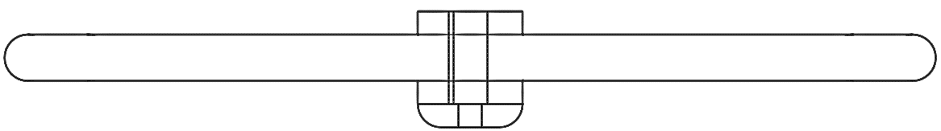











$$F_{Ax}$$
$$F_{Wx}$$
$$F_{PULL}$$
$$z$$
$$x$$
$$F_{PUSH}$$
$$F_{PUSH}$$
$$F_{Rpush}$$
$$F_{PULL}$$
$$F_{PULL}$$
$$F_{Rpull}$$

Slide 2
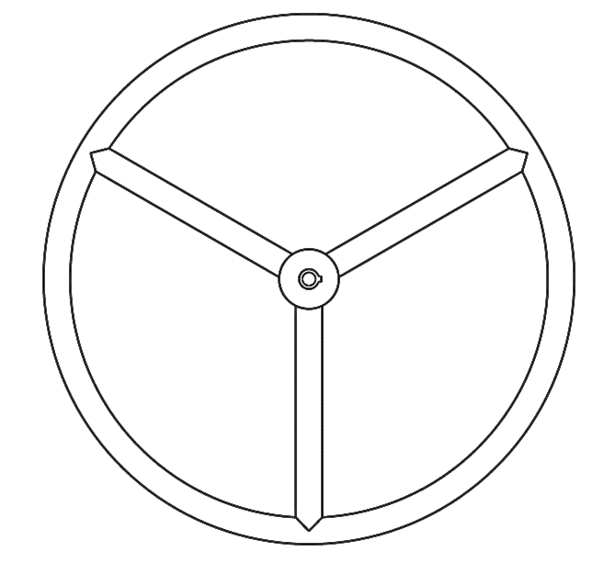




$$y$$
$$x$$
$$F_{Wx}$$
$$F_{Ax}$$

Slide 3
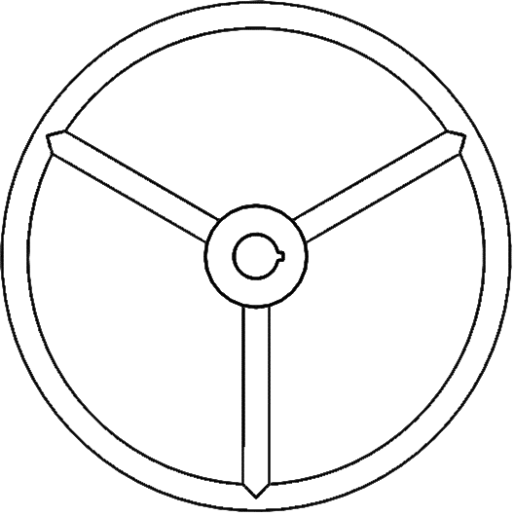

















$$F_{Ax}$$
$$y$$
$$x$$
$$T_{in}$$
$$x$$
$$F_{PUSH}$$
$$F_{PULL}$$
$$z$$
$$F_{KWin}$$
$$F_{Wx}$$
$$F_{Ax}$$
$$F_{Rpull}$$
$$F_{Rpush}$$
$$F_{Wy}$$
$$F_{Wx}$$
$$F_{PUSH}$$
$$F_{PULL}$$

Slide 4











$$y$$
$$F_{KWout}$$
$$F_{Rpull}$$
$$F_{P}$$
$$x$$
$$y$$
$$x$$
$$F_{HEIM}$$
$$F_{KWin}$$
$$F_{SA}$$

Slide 5















$$x$$
$$F_{Wx}$$
$$F_{M2x}$$
$$z$$
$$Welded$$
$$F_{M1x}$$
$$x$$
$$z$$
$$F_{P}$$
$$F_{M1z}$$
$$x$$
$$F_{Rpush}$$
$$z$$
$$F_{Upush}$$
$$F_{Upush}$$

Slide 6






$$F_{Wx}$$
$$F_{M2x}$$
$$V$$
$$Welded$$
42 N
-277.5 N
$$M$$
$$\text{−34 687 }\text{Nmm}$$

Slide 7
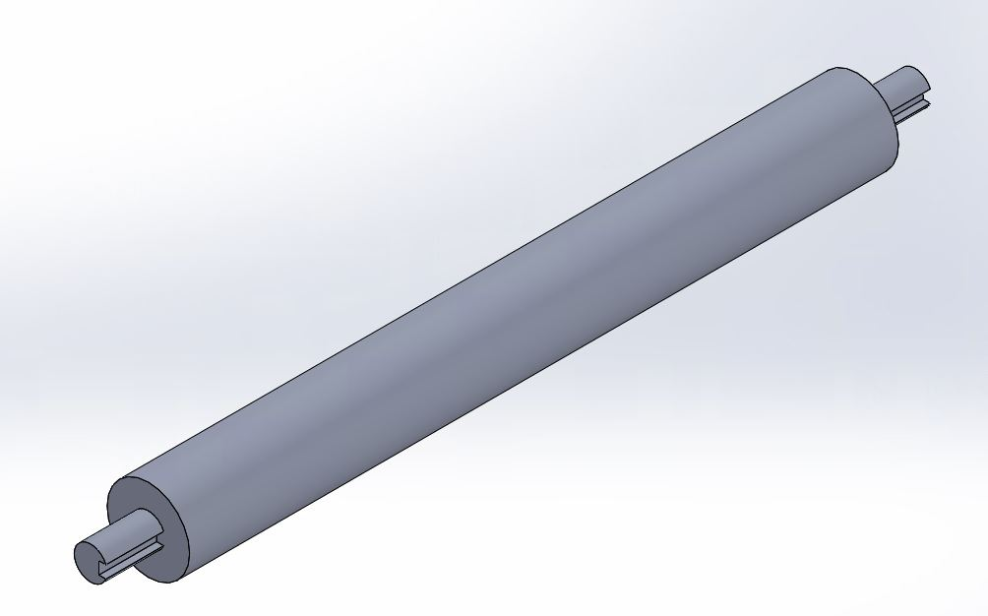
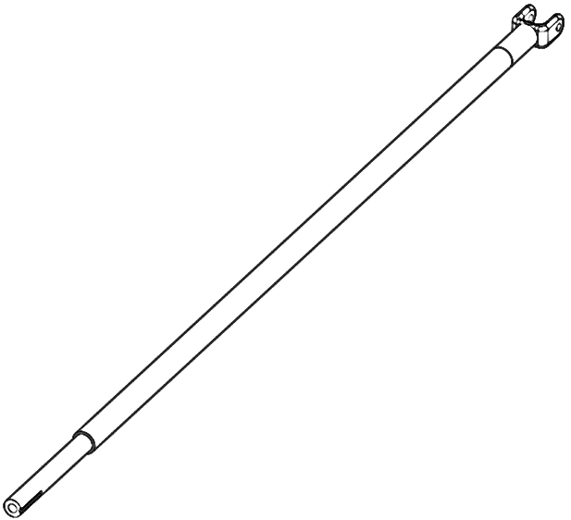
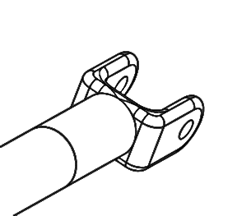





































$$z$$
$$F_{KU1}$$
$$x$$
$$F_{M2z}$$
$$y$$
$$F_{M1y}$$
$$z$$
$$Welded$$
$$F_{Uz}$$
$$F_{M1x}$$
$$F_{Rpush}$$
$$F_{P}$$
$$F_{Upush}$$
$$F_{M1z}$$
$$F_{Uz}$$
$$F_{Wy}$$
$$F_{M2y}$$
$$F_{M1z}$$
$$F_{P}$$
$$F_{KS}$$
$$F_{Ux}$$
$$F_{Iz}$$
$$F_{Uz}$$
$$Welded$$
$$F_{Uz}$$
$$y$$
$$z$$
$$F_{Ux}$$
$$x$$
$$F_{Uz}$$
$$x$$
$$F_{Ux}$$
$$z$$
$$F_{Ux}$$
$$F_{Uz}$$
$$y$$
$$F_{KWout}$$

Slide 8
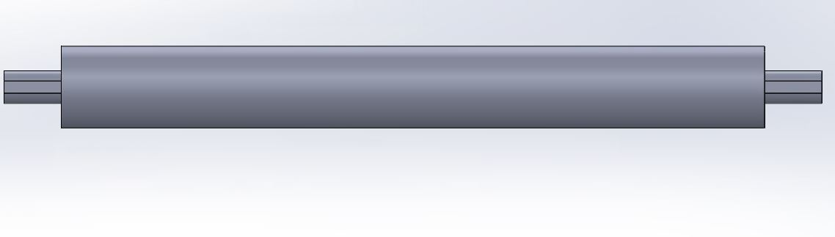




























$$y$$
$$F_{M2y}$$
$$F_{KU1}$$
$$x$$
$$F_{P}$$
$$F_{M1x}$$
$$F_{KS}+$$
$$F_{Ix}$$
$$F_{M1y}$$
$$x$$
$$F_{Wx}$$
$$z$$
$$F_{M2x}$$
$$F_{Ux}$$
$$F_{Uz}$$
$$F_{Uz}$$
$$F_{Upush}$$
$$F_{Ux}$$
$$Welded$$
$$F_{M1x}$$
$$F_{Uz}$$
$$x$$
$$Welded$$
$$F_{Ux}$$
$$z$$
$$F_{Ux}$$
$$F_{Uz}$$
$$y$$

Slide 9












$$x$$
$$x$$
$$F_{Ux}$$
$$F_{UBx}$$
$$z$$
$$z$$
$$F_{UBx}$$
$$F_{UCz}$$
$$F_{Uz}$$
$$F_{UBz}$$
$$F_{UBz}$$
$$F_{UCx}$$

Slide 10
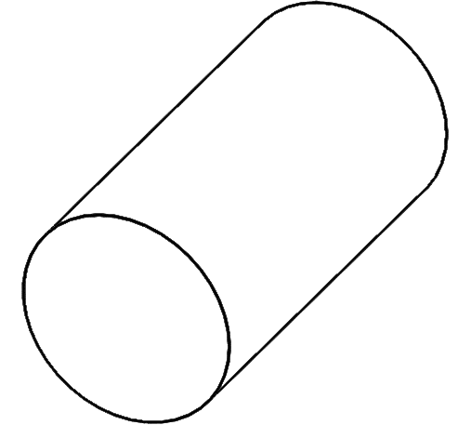











$$z$$
$$F_{UBz}$$
$$x$$
$$y$$
$$y$$
$$z$$
$$F_{UCz}$$
$$x$$
$$F_{UBx}$$
$$y$$
$$F_{UCx}$$

Slide 11
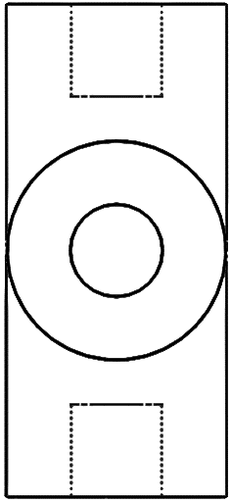
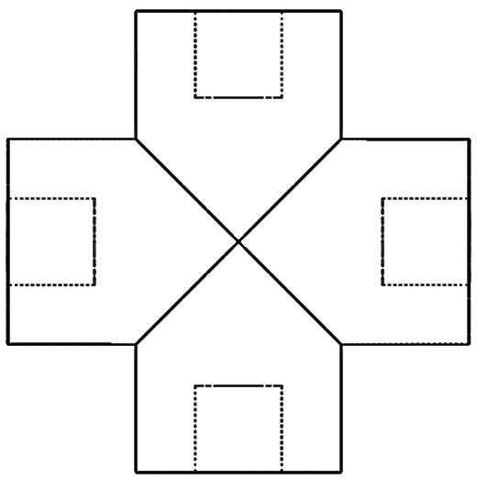












$$x$$
$$x$$
$$y$$
$$z$$
$$F_{UCz}$$
$$F_{UCx}$$
$$F_{UCy}$$
$$F_{UCz}$$
$$F_{UCz}$$
$$F_{UCz}$$
$$F_{UCx}$$
$$F_{UCy}$$

Slide 12
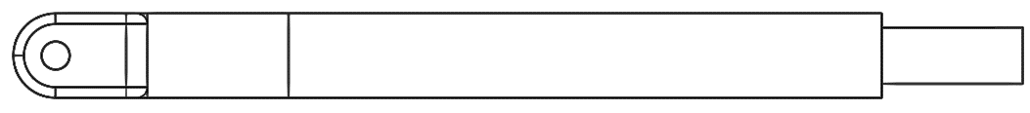
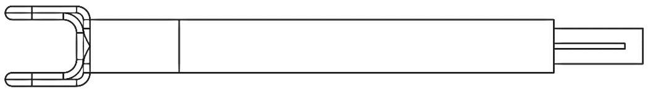

























$$y$$
$$z$$
$$F_{B1y}$$
$$F_{B2y}$$
$$F_{RPz}$$
$$F_{Uy}$$
$$F_{Uz}$$
$$F_{Uz}$$
$$F_{M3y}$$
$$F_{RPz}$$
$$F_{Uy}$$
$$Welded$$
$$F_{M3y}$$
$$F_{Py}$$
$$x$$
$$F_{B1x}$$
$$F_{B2x}$$
$$z$$
$$F_{Uz}$$
$$F_{KP}$$
$$F_{RPz}$$
$$F_{RPz}$$
$$F_{Uz}$$
$$Welded$$
$$F_{Px}$$

Slide 13















$$y$$
$$F_{B1y}$$
$$z$$
$$F_{U2}$$
$$F_{B2z}$$
$$θ$$
$$Welded$$
$$F_{M3y}$$
$$x$$
$$F_{B1x}$$
$$F_{B2x}$$
$$z$$
$$F_{Uz}$$
$$F_{KP}$$
$$F_{RPz}$$
$$F_{RPz}$$
$$F_{Uz}$$
$$Welded$$
$$F_{Px}$$

Slide 14









$$y$$
$$z$$
$$F_{U2}$$
$$θ$$
$$F_{B2z}$$
$$Welded$$
$$F_{M3y}$$
$$x$$
$$V$$
210.23 N
-555 N
$$M$$
$$\text{−}\text{27 750} \text{Nmm}$$

Slide 15
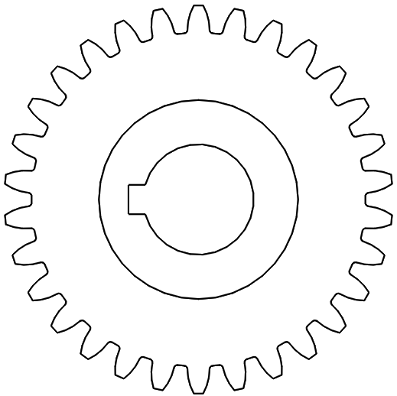







$$x$$
$$F_{Px}$$
$$y$$
$$F_{Py}$$
$$F_{KP}$$
$$F_{Pt}$$
$$F_{Pr}$$

Slide 16
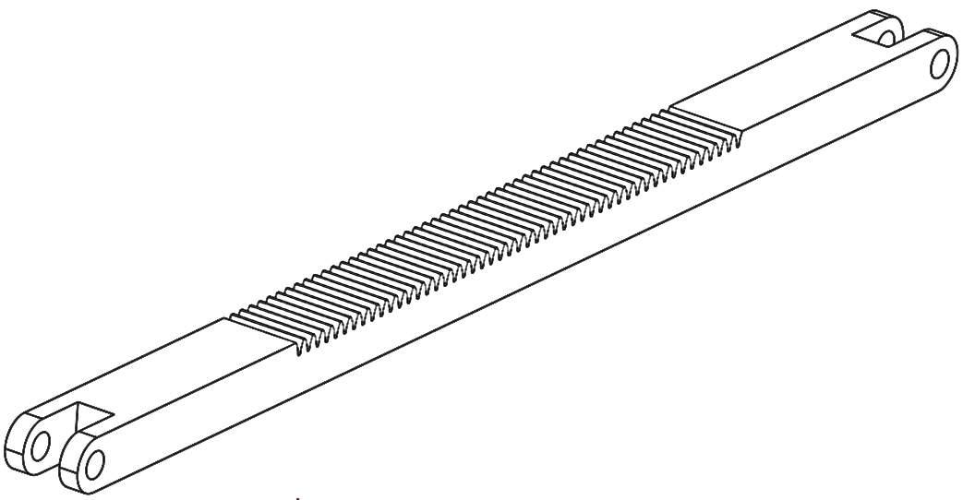

















$$F_{R2x}$$
$$y$$
$$F_{R2x}$$
$$F_{Pr}$$
$$x$$
$$F_{Pt}$$
$$F_{R2y}$$
$$F_{C2z}$$
$$F_{R2y}$$
$$z$$
$$F_{C2y}$$
$$F_{R1y}$$
$$F_{R1y}$$
$$F_{C1z}$$
$$F_{R1x}$$
$$F_{R1x}$$
$$F_{C1y}$$

Slide 17
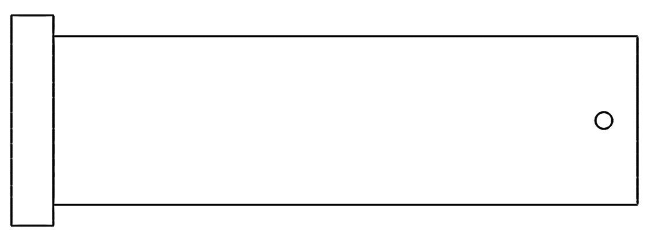










$$F_{Hx}$$
$$x$$
$$z$$
$$F_{R1x}$$
$$F_{R1x}$$
$$F_{R1y}$$
$$F_{R1y}$$
$$y$$
$$z$$
$$F_{Hy}$$

Slide 18
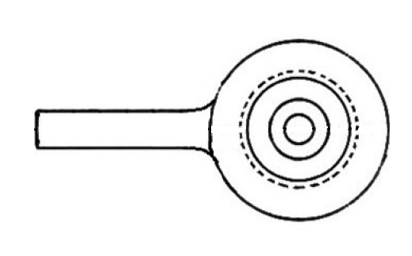





$$y$$
$$F_{Hx}$$
$$x$$
$$F_{TR}$$
$$F_{Hy}$$

Slide 19
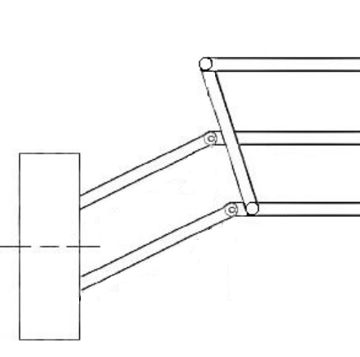


$$A$$
$$B$$

Slide 20
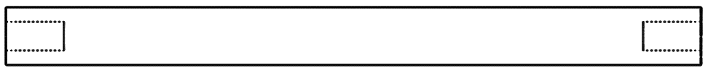




$$F_{TRout}$$
$$y$$
$$x$$
$$F_{TRin}$$

Slide 21


$$V$$
$$M$$

Slide 23
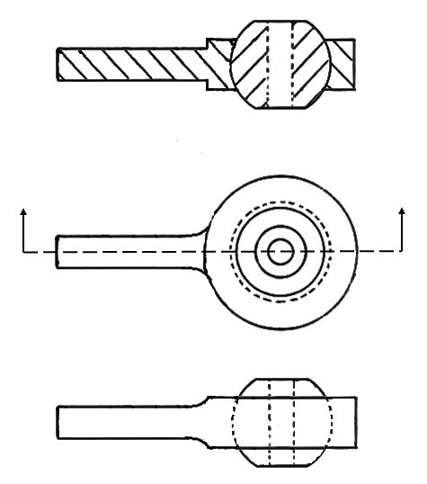







$$y$$
$$F_{S}$$
$$x$$
$$M_{H}$$
$$F_{HSR}$$
$$F_{HT}$$
$$F_{S}$$

Slide 24











$$y$$
$$z$$
$$F_{UBoy}$$
$$x$$
$$x$$
$$F_{UBx}$$
$$F_{UCy}$$
$$F_{UCz}$$
$$x$$
$$y$$
$$z$$

